Slide 1

Age-friendly Business
AFPEI
Marcy Bouchie, Coordinator

Slide 2
Introduction
This age-friendly business guide is designed to assist you in developing an Age-friendly Business Program for your community. The age-friendly training in this toolkit will provide businesses with practical, low-cost tips to engage the seniors’ market and in doing so facilitate changes that will provide a positive experience for everyone, regardless of their age.

Slide 3
SECURING FUNDING
If you need funding (for anything from printing to running a project), there are various possible sources available to support your project, for example:
  New Horizons for Seniors Program
  Seniors’ Secretariat
  Municipal grants
  Private sponsors

Slide 4
Research & development of your own af business manual
There are many manuals for AF Businesses (e.g., AF Niagara, AF Kawartha Lakes) you will find online that have already been developed by other organizations.
Read through manuals to gather information that may be relevant to businesses in your community and add some ideas of your own!
Use our AF Business manual (included for your reference) as well

Slide 5
Research & development of
YOUR OWN AF BUSINESS manual
Decide which information you would like to include in your own AFB manual
Create a draft version of a manual that will be reviewed by a small committee of people of all ages, including seniors, for input and feedback
Strike a small committee of seniors and others who will provide feedback on your draft manual. You may find out that there are needs you have not considered!
Using the feedback from the reviewing committee, prepare a final draft of your manual and arrange for printing and sharing with businesses

Slide 6
Train mentors to share AF knowledge
Enlist/engage a group of champions in your community who will present/train the businesses using your manual
  Offer food as a social
Set up a training day for the mentors to learn about
  Age-friendly communities and
    how to make a business more age-friendly
    During training, have the mentors
    train to work in pairs and
    practice presenting the training manual within the group.

Slide 7
Getting buy-in from businesses
The businesses will need to feel like this training is an investment for them
  cold call the businesses in your area to assess interest
  invite them to a luncheon (they have to eat anyway!) or a short meeting
  or meet them at their own convenience, at their place of business
  don’t forget: small business owners may not have time to set aside for additional outside activities
  Summarize the project

Slide 8
Getting buy-in from businesses
  What’s in it for them?
    Know how much time it will take to have them be trained
    Offer to train their staff at their convenience, in their place of business
    Attract seniors (~45% of the buying power!), and in doing so your business is also inviting for people of all ages, stages and abilities
    Certificate for their wall and
    Decal to display in your window
    Public display of the businesses who chose to become AF and their willingness to put in the time to do so

Slide 9
Spreading the word
    How will people know that a business is age-friendly?
      The business will be presented with a certificate
      the business will receive a window decal to display for customers
      the business can share their AF Business certification and training on their social media
      The business can add a picture of the decal to their advertising
      Create a map of your area indicating where AF businesses are located
        Have a legend with certified AF business names

Slide 10
The Age Friendly Business Program
Identify your community partner(s) and your funding partner(s) who have enabled you to create a program to help interested businesses in the community to become more aware of issues for seniors, people with mobility issues, families with children etc. and more responsive to the needs of the same. The goal is to provide all people with a positive experience in local businesses. If they have this, they’ll tell their friends and come back. It’s a WIN–WIN !

Slide 11
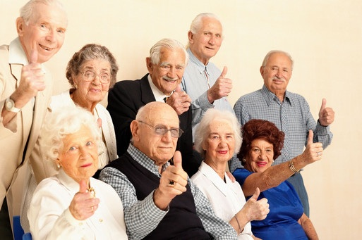



Slide 12
So why be an Age-Friendly Business?
Customers spend their money where they have had a positive and friendly experience.
Seniors have a lot of purchasing power and the time to shop
Age-Friendly initiatives make your business comfortable for everyone (seniors, pregnant women, people with injuries, parents with strollers, people with mobility issues)
Word will get around and you will have more customers!

Slide 13

What do businesses need to consider about their customers as they age?
Most seniors (55+) today experience healthy aging, and lead busy active lives.
Seniors want to be fit, enjoy social gatherings, participate in the community & find useful employment.
There are natural aging changes that effect the abilities and lifestyle of all seniors.
There are also short-term (acute) conditions that may develop and for some, longer term (chronic) diseases and impairments.

Slide 14
What are you doing already to be
Age-Friendly?
Have you made your entrance inviting, safe and easily accessible throughout the year?
Have you made your aisles wide enough for walkers or wheelchairs?
Have you posted clear signage to the washrooms?
Have you created a website that is easily navigable?

Slide 15


What Kindness can you bring to your business for agiNg customers?
Let’s explore what happens
when you age…

Slide 16
Natural Decline in the Five Senses
Hearing (Difficulty following conversation, balance, ringing in the ears, difficulty hearing high frequencies)
Vision (Depth perception, night vision, colours, blurriness)
Taste (loss of appetite, decreased ability to taste, dry mouth, difficulty swallowing)
Smell (Decreased ability to smell, risk of not smelling harmful vapors)
Touch (increased risk to injure skin, numbness to hot & cold)
What do service providers need to think about?

Slide 17

Here are some suggestions
Reduce background noise
Speak clearly face on, do not yell, do not talk quickly
Clear signage, large print menus
Adequate lighting
Offer a magnifying glass
Offer condiments & seasonings
Be aware of the temperature
Tell customers when the plate is hot

Slide 18

What other suggestions do you have?

Slide 19
Chronic Conditions:
Changes to the Cardiovascular (Heart)
and Respiratory (Breathing) Systems
Shortness of breath
Tires easily
Cough
Pain
Swelling in ankles and feet
What do service providers need to think about?

Slide 20

Some Suggestions
Offer seating or benches
Offer water
Provide breaks
Provide mobility scooters
Monitor non-verbal body language
Ask if they would like assistance

Slide 21

What other suggestions do you have?

Slide 22
Changes to Mobility
Weakness and/or pain of bones, muscles, joints
Decreased Range of Motion
Poor Balance
Risk to Fall
What do service providers need to think about?

Slide 23

A few more suggestions
Offer to open doors or carry out purchases
Watch for non-verbal cues – Does the person look dizzy
Shovel the snow & clear ice at your entrance
Offer home delivery
Accessible and Seniors’ parking spaces

Slide 24

What other suggestions do you have?

Slide 25
Changes to the Brain
Decreased size and blood flow
Confusion (can be short term due to illness or medication)
Dementia (Long term, progressive)
Forgetful
Repeats oneself
Becomes agitated
Loses belongings
Has struggles communicating
What do service providers need to think about?

Slide 26
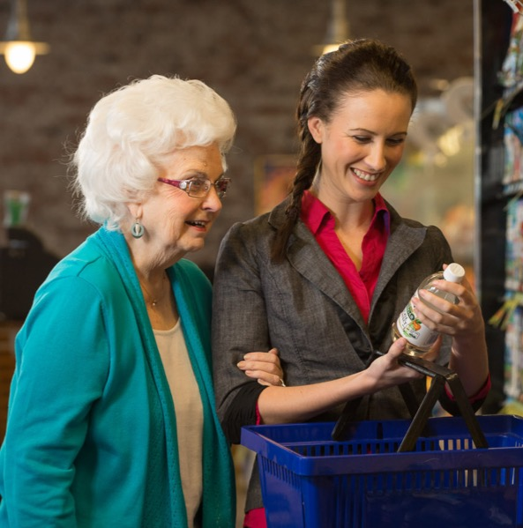
Some suggestions
Remain calm
Be patient, flexible and understanding
Do not take things personally; the disease typically causes the symptoms
Keep a positive attitude
Treat the person with dignity and respect
Avoid arguing
Avoid embarrassing the person

Slide 27
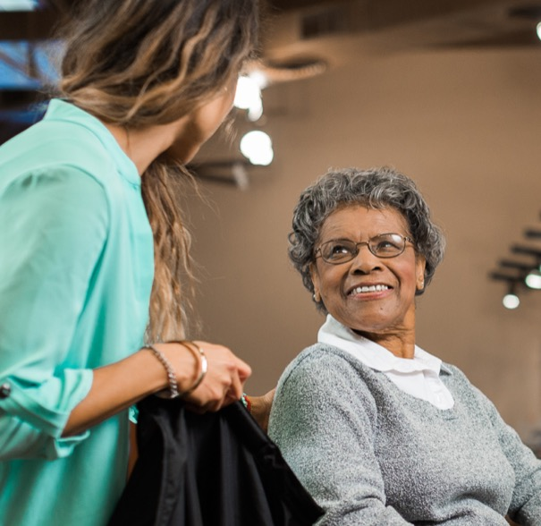
Interact
Introduce yourself and greet the customer
Politely address the customer by sir or ma’am
Approach the customer slowly from the front
Smile
Speak to the person at eye level
Speak slowly and calmly, while using short, simple words

Slide 28
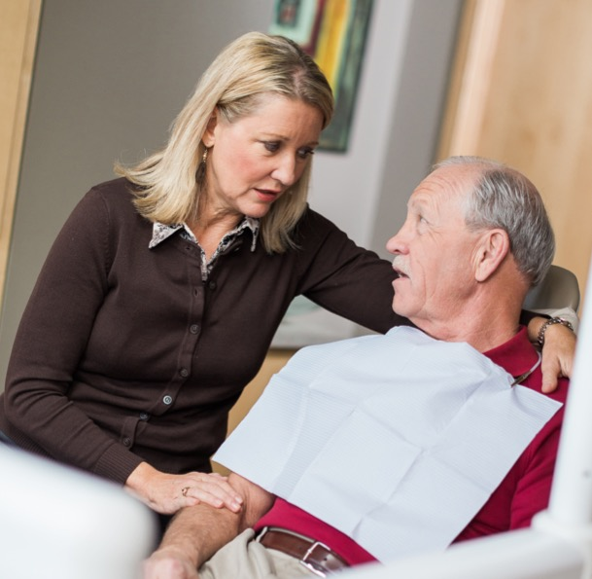
Interact (continued)
Use a comforting tone of voice
Allow enough time for the individual to respond
Avoid interrupting the customer
Limit distractions during communication
Increase the use of gestures and other non-verbal communication techniques
Respect their feelings
Ensure all immediate basic needs are met

Slide 29
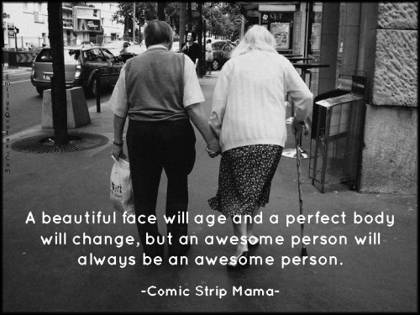
What other suggestions do you have?

Slide 30
What our local community members said about a positive service experience
I will go back to a business where:
I am acknowledged and greeted with a smile
Staff are patient and explain the product
Staff physically show me where things are
Staff are aware and respectful of my time
When I phone, staff avoid leaving me on hold
I am valued as a potential employee. I am reliable & capable.
Staff are sensitive to my needs – sometimes I struggle with my health

Slide 31
Thank you for your commitment to an age-friendly community

Slide 32
If you would like further information or to talk more about this topic please contact
Marcy Bouchie, Coordinator
Age-friendly PEI
agefriendlypei@gmail.com
902-303-6444

